Slide 1


Job recruitment system
Arnold arisa gekobe
101484

Slide 2

Job recruitment system
In organizations recruitment is inevitable. However, a lot of people miss out on the opportunity.
Lessen the time required in going through a lot of resumes.
People with the required skill are selected whereas those not qualified are not.
Low cost involved in the process by using the system

Slide 3

System requirements
The system should allow for user login as well as authentication.
The system should accept applicant’s details and store them.
The system should check if the applicant is qualified.
NON-FUNCTIONAL REQUIREMENTS
The system is to be a web-based application
The system is to generate periodical reports
The system should be secure

Slide 4

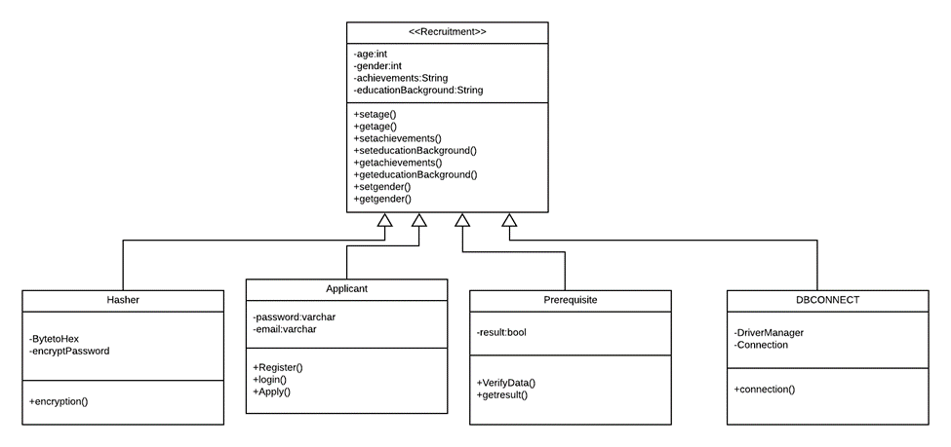
CLASS DIAGRAM

Slide 5

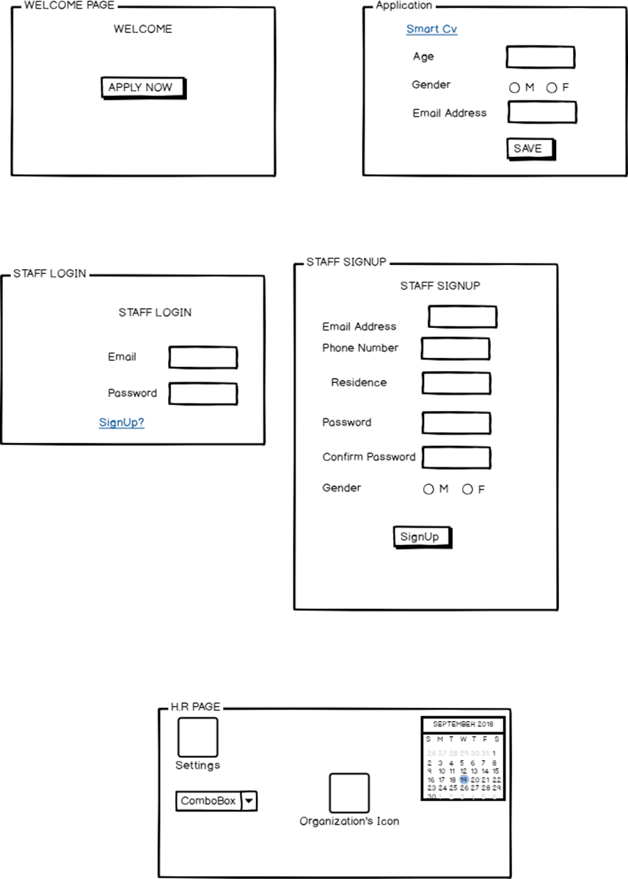
INTERFACE DIAGRAMS

Slide 6

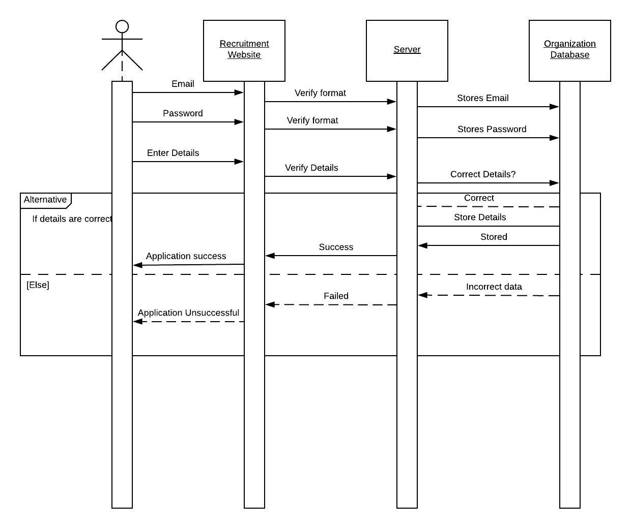
SEQUENCE DIAGRAM

Slide 7
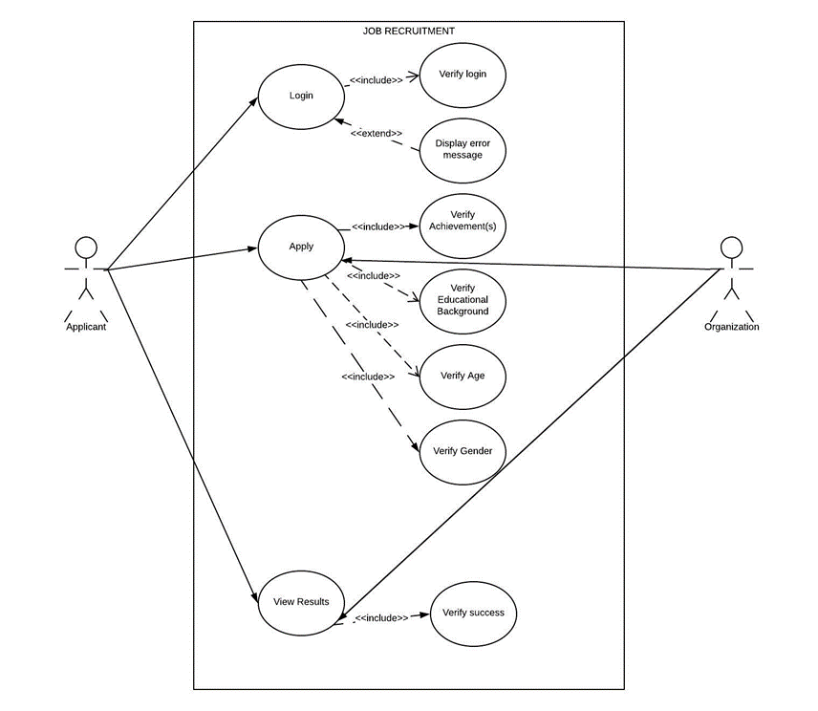
USE CASE DIAGRAM

